Slide 1
PDF Table Extraction
Divya Shah
Notes:
Hello, this summer I have been working on my project which is about creating a pipeline which can extract tables from digital and scanned PDFS.

Slide 2
Agenda
Things I learned
Problem Statement
Background on Table Extraction
Pipeline
Extraction Results
Limitations
Notes:
During this presentation I’ll begin with things I learned while working on this project. Then I’ll define the problem and walk through some background on table extraction. From there, I will explain the pipeline I built, review extraction results, and discuss limitations I faced throughout working on this project.

Slide 3
Problem Statement
Extracting tables from PDFs is difficult as many tables are unstructured (not in neat rows/columns)
Manually processing tables is tedious and time-consuming
Goal: Build an automated pipeline that can extract tables from digital and scanned PDFs and save them as structured CSV/Excel spreadsheets
Notes:
Extracting tables from PDFs seems simple until you realize most PDFs don’t encode tables structurally. Text blocks are scattered. Headers merge. Rows shift. Manual extraction is slow, error-prone, and unsustainable for larger scaled datasets. My goal in this project was to build a pipeline that takes in digital and scanned PDFs, and outputs structured CSVs and excel spreadsheets— which would be ready to clean and use for analysis.

Slide 4
Process of identifying, recognizing, and extracting structured data from documents, converting it into a usable format like a spreadsheet or database table.
Key Terms:
Table Detection (TD): Finding tables in a PDF
Table Structure Recognition (TSR): Identifying rows, columns, and headers the table
Table Content Recognition (TCR): Extracting the text/date from tables
Background on Table Extraction
Notes:
Table extraction is the process of identifying, recognizing, and extracting structured data from documents, converting it into a usable format like a spreadsheet or database table. This involves detecting the table's boundaries, recognizing rows and columns, and then extracting the data within those cells. There are 3 main steps to table extraction.
Table Detection (TD): Finding tables in a PDF.
Table Structure Recognition (TSR): Identifying rows, columns, and headers the table
Table Content Recognition (TCR): Extracting the text/date from tables.
These steps get tricky when documents have stamps, rotated elements, or uneven formatting.

Slide 5
Different kinds of businesses need automated table extraction for financial reports, invoices, research papers, etc.
Saves time and reduces human errors in data processing.
Research and Academia: AI-powered table extraction helps scientists and researchers analyze large datasets from published papers
Government and Legal Documents: Automating table extraction improves data organization for regulations, policies, and audits.
AI Advancements: Contributes to document AI, making it easier for future models to handle unstructured tables.
Why is this important?
Notes:
Why would this project be useful? Table extraction supports everything from audit reviews to scientific data entry, financial reports, clinical study tables,— which all need clean data. Even within Gilead, table-heavy documents like lab reports or scanned forms are used everywhere. And for AI research, clean extractions are important for training datasets and model evaluations.

Slide 6
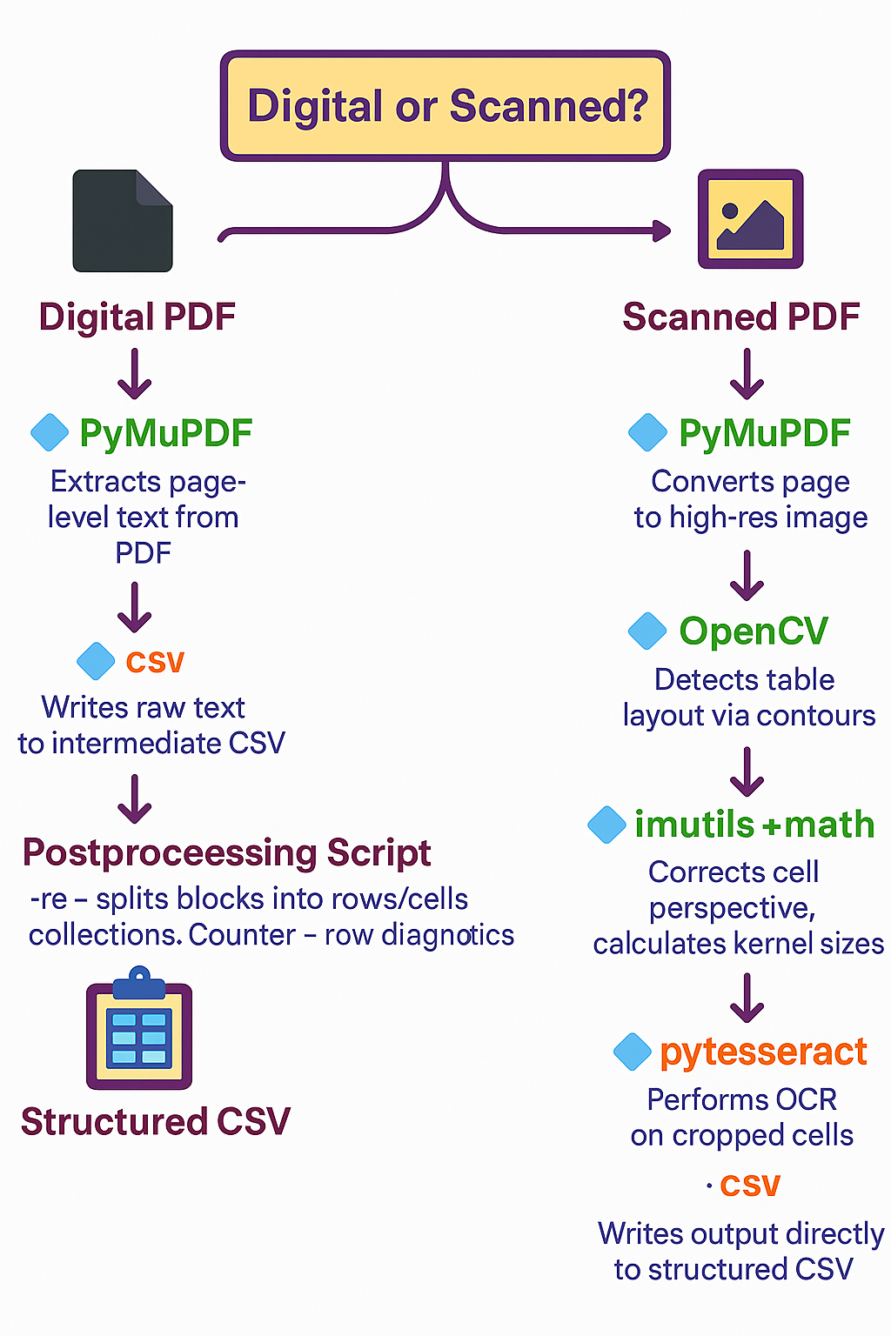
Notes:
So let’s walk through how the pipeline runs. First, it checks what kind of PDF we’re dealing with—digital or scanned. This distinction is important, because the extraction method depends entirely on the input type. I used PyMuPDF to inspect the first page. If it has embedded text, I classify it as a digital PDF. If it doesn’t, it’s likely just an image—so I treat it as a scanned PDF. This auto-routing step makes sure the right tools are used.
Digital flow: If the PDF is digital and contains selectable text, I use PyMuPDF to extract text blocks. PyMuPDF is lightweight, fast, and gives block-level positions, which helps later in reconstructing structure. I save this raw output into a CSV, where each row is a separate block of text.
Then, a custom postprocessing script kicks in, it uses regex and spacing heuristics to split the blocks into proper rows and columns. Diagnostics like row-length analysis help validate the output before saving the final structured table. I choose PyMuPDF because it handles embedded text well, works offline, and doesn’t require any training.
Scanned flow: For scanned PDFs, where the content is just an image of the page with no embedded text, I still use PyMuPDF first, but this time to render the page as a high-resolution image. Then I pass it through OpenCV, which detects table contours using edge detection and thresholding. I used the imutils library to fix the perspective of skewed tables and math to size image filters based on page dimensions—this helps cleanly separate cells before OCR. Each cropped cell image then goes to pytesseract, the OCR engine, to extract text. The output gets stitched together into structured rows and saved as CSV.
I used OpenCV to help detect the structure of messy tables—it gave me visual control when things aren’t cleanly formatted. Then it relies on Pytesseract for OCR because it’s easy to plug in and handles scanned text really well.

Slide 7
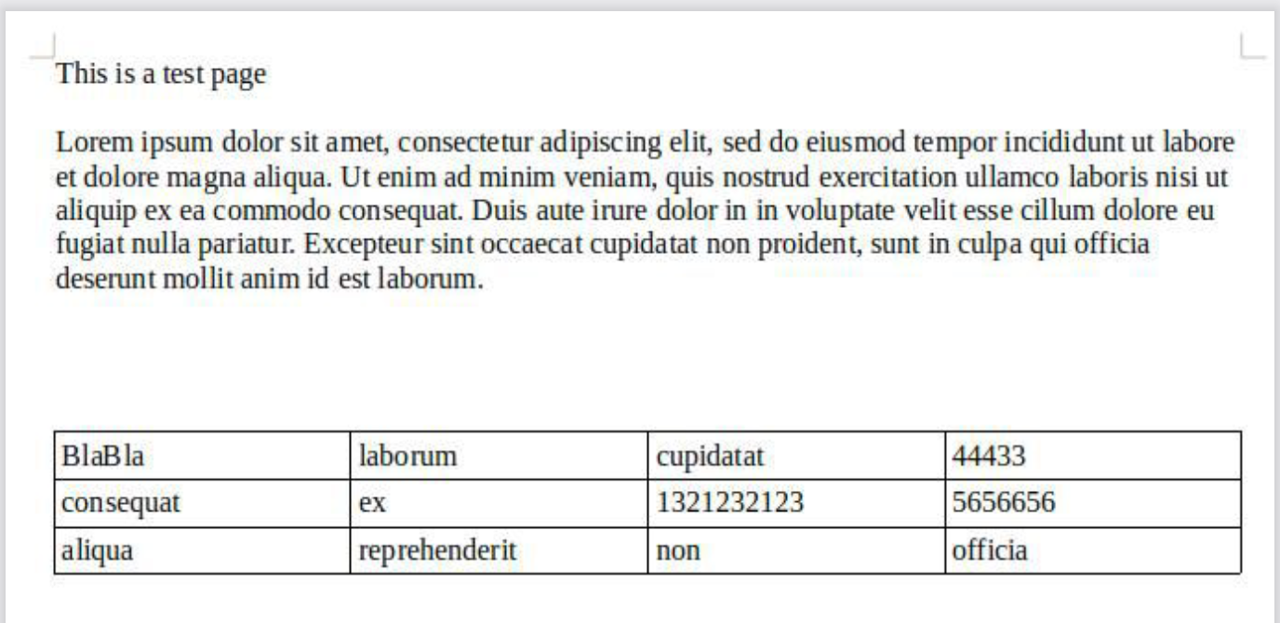
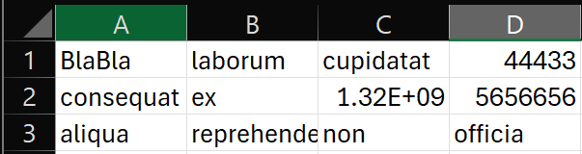
Notes:
This is an example of the input and output of a scanned PDF. It detected the table only, and extracted only the table, disregarding the paragraph. This is an example of table detection.

Slide 8
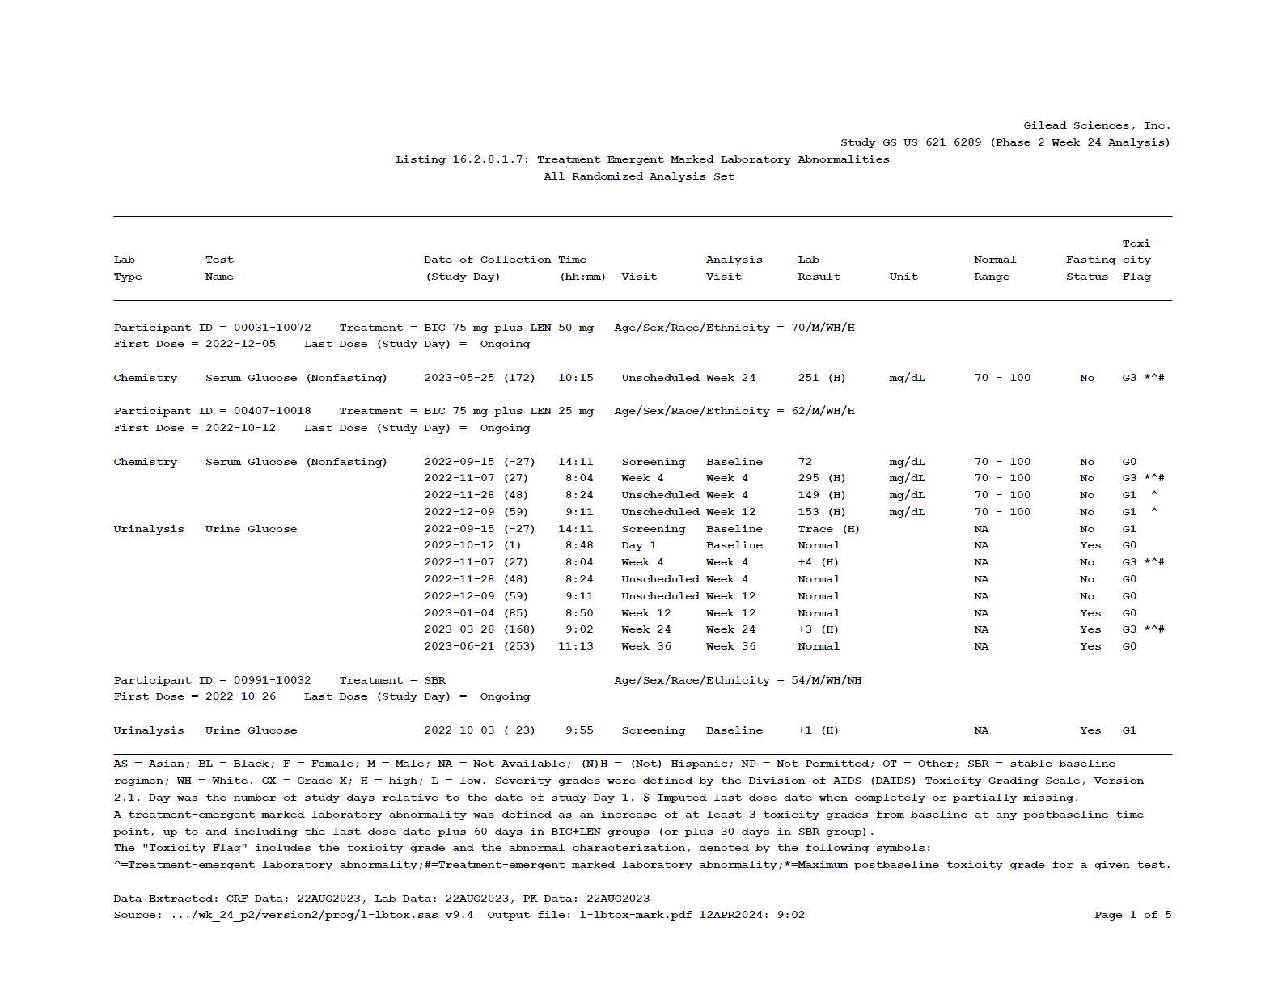
Notes:
This is an example of the Gilead pdf document, this is 1 out of 5 pages of a digital pdf. As you can see it seems mostly structured, but you can see the headers “Date of Collection” and “Time”. Since they are closer together and look like one header, my pipeline struggled with this example.

Slide 9
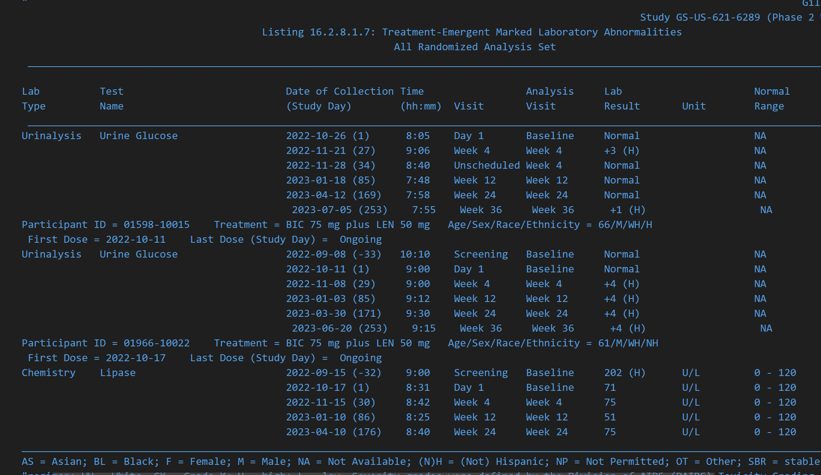
Digital PDF extracted using PyMuPDF
Output: block-level text saved to CSV
Text is clean, but not yet in table format
Each line represents a separate text block from the PDF
Structure is still implicit—columns aren’t defined yet
Notes:
This is the first round of extraction with PyMuPdf. It looks structured, clean, and converted into text, but not in usable table format. The problem with this though, was that there were no separate columns. Every row was in one column, meaning they weren’t defined yet.

Slide 10
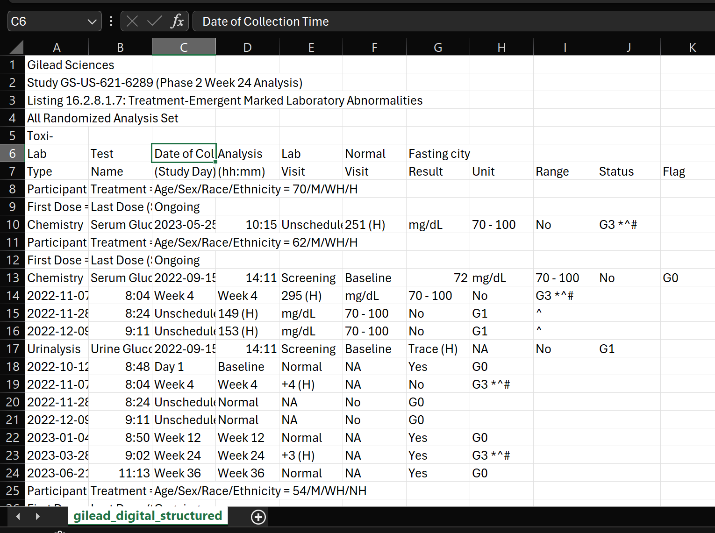
Digital PDF extracted using postprocessing
Blocks are split and aligned into rows and columns
Columns are explicitly defined: date, test name, result, unit, range, etc.
Content is usable for analysis, though formatting still needs refining
Some header names are merged
Some rows have extra whitespace or misaligned entries
Notes:
Then, I used a script that aligns text blocks into rows and columns using regex, spacing diagnostics, and some heuristic logic. You can see some of the columns like LAB, TEST, ANALYSIS, etc. defined clearly now. It still isn’t perfect as the whitespace may cause drift. But this final step does transform raw blocks into structured outputs.

Slide 11
Limitations & Conclusion
Some PDFs are too messy for clean extraction (e.g., Gilead.pdf), some rows may shift or misalign
Extraction success can vary depending on how clean or messy the original scanned PDF is
Random marks, stamps, shadows, or weird layout elements
Hard to find scanned PDFs for testing
Extracts only English documents
OCR occasionally misreads similar characters
e.g., "O" vs "0", "l" vs "1", which could distort numeric results
These challenges are part of working with real-world data, and they pushed me to be creative and resourceful.
Notes:
Some PDFs—like the one from Gilead—are too messy for clean extraction. Scanned pages might have stamps, shadows, or layout quirks. OCR struggles with characters like ‘O’ vs ‘0’ or ‘l’ vs ‘1.’ It was harder to find scanned PDFs for testing as well so the pipeline would work differently with other scanned PDFs and may need more adjustments based off those extraction results. Firewall constraints limited access to certain cloud tools, so I adapted with offline methods. Also, column alignment isn't always perfect, since even after processing, some rows may have shifted or misaligned depending on the layout. Even with facing all of these challenged, I learned they are part of working with real-world data, and they pushed me to be more creative and resourceful.

Slide 12
Things I learned
Building a modular pipeline that handles both digital and scanned PDFs
How to read, learn, and implements knowledge from research papers
Choosing which tools needed based on input type, extraction needs, and installation constraints
Extract text using PyMuPDF and perform OCR with OpenCV + Tesseract
Improved debugging and troubleshooting skills
Overall, this project gave me hands-on experience balancing tech tools with practical problem-solving, as well as experience in thoughtful decision-making, professional collaboration, and presenting complex work with clarity.
Notes:
This project helped to sharpen my thinking around tool selection and how to choose workflows based on document type—digital vs. scanned. For example, I started with Hugging Face tools but had to use other methods due to company constraints. At the beginning of my internship, I read a few research papers in order to help me with my project, and that helped me learn how to read, learn, and implement knowledge from these papers into my projects. I learned how to see which libraries worked best for the inputs I had, and outputs I wanted. I improved my debugging and troubleshooting skills due to many SSL errors face as well. I also learned about the different extraction methods and libraries that are readily out there for use in extraction projects like these. Overall , this project and my internship experience overall gave me hands-on experience balancing technological tools with practical problem-solving, as well as experience in thoughtful decision-making, professional collaboration, and presenting complex work with clarity.

